Slide 1
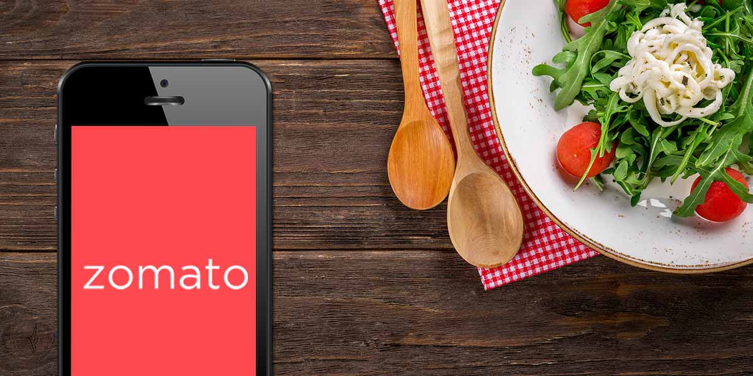
Analysis of the Zomato Restaurants in Kolkata.
Research Project by
Shreetama Dasgupta

Slide 2
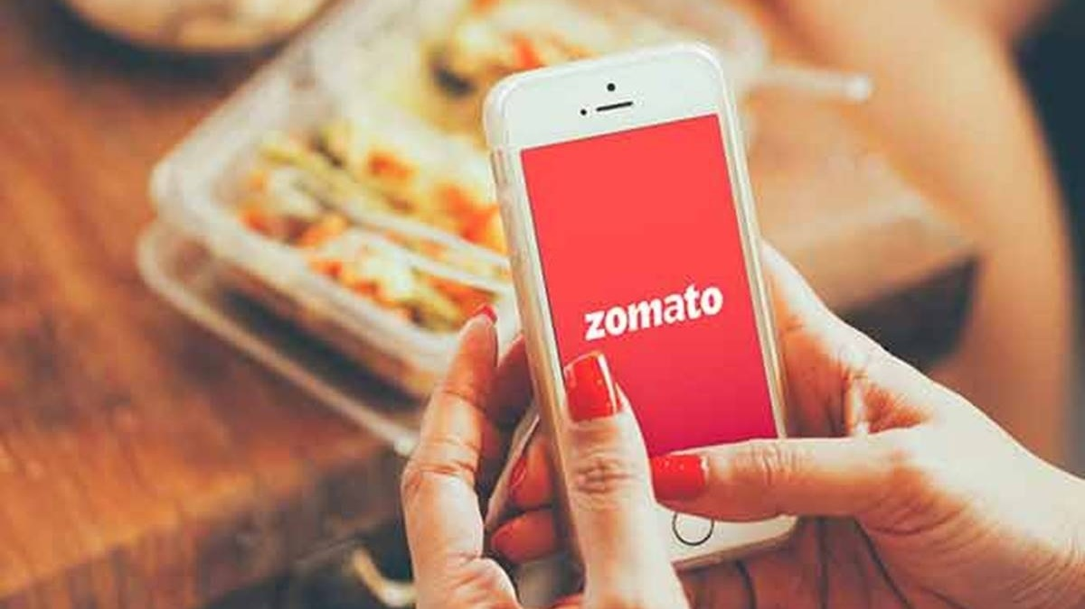
About Zomato:
Zomato is one of the most comprehensive and user-friendly apps where people can search for nearby restaurants and cafés, order food online, and get it delivered at their doorstep in no time. Moreover, accurate information about restaurants can also be obtained as it provides menus, reviews, and ratings. Based on that, users can place orders and enjoy lip-smacking food at their homes.

Slide 3

About the dataset:
This tabular dataset consists of all restaurants in Kolkata. This data has ratings and review details, the cuisines available, the approximate price for two persons, etc.
The dataset consists of :
19 Fields
4923 Records
4923 records

Slide 4
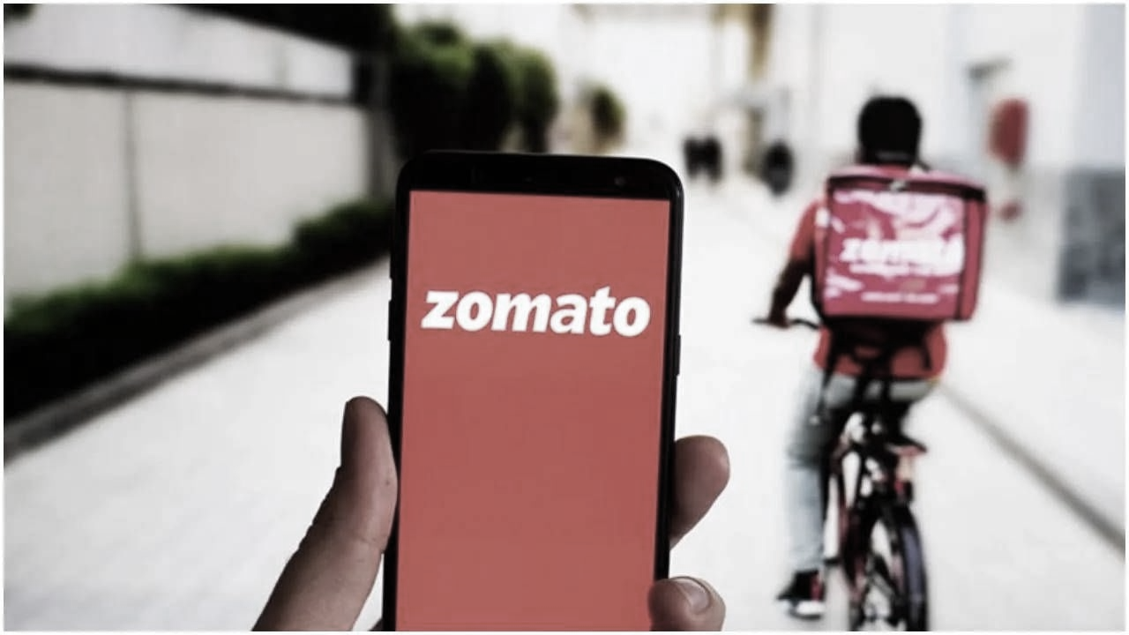
Business Objectives
We will be analysing the dataset with the following business objective:
Finding out about the affordability of the restaurants in Kolkata listed with Zomato
Restaurants having the maximum dinner ratings
Enquiring about the restaurants.
Locations having maximum number of restuarants
Restaurants having the maximum delivery ratings.
Status of vegetarian restaurants in Kolkata
Is there a relation between cost and popularity?
Some of the popular cuisines in Kolkata.

Slide 5
The Project Road Map
Data Understanding
The dataset consisted of 4923 records and 19 Fields.
The dataset was in csv format.
Data Analysis
The following excel tools were used to analyse the data.
a)Lookup Functions
b) Pivot tables
c) Conditional Formatting
d)Charts
e) Slicers
Pre-processing of the data
Dataset was converted into excel format.
The table was formatted so as to make it dynamic.
A few columns were added.
Summarization
The outcome with respect to the business objectives were presented in a dashboard.
Some meaningful business insights were obtained.

Slide 6
Barbeque Nation and Natural Ice cream are the highest rated restaurants in terms of dinner ratings

Slide 9
Most of the pure vegetarian restuarants perform average in Kolkata

Slide 11
North Indian, Chinese and Desserts are some of the most popular cuisines.

Slide 12


